Slide 1
Excess COVID-19 Deaths Modeling and Comparison by State
Davit Sargsyan June 2024

Slide 2
Part I: 2010-2022 Data with Causes of Death

Slide 3
Data processing and subsetting
DeathDaily = Death/daymonth (i.e., average daily death = average monthly death/number of days in that month)
Removed records: Date >= 2022-07-01
Removed states with max(DeathDaily) <10 in Cerebrovascular diseases (I60-I69). 20 out of 51 states left.
Divided data into training (before 2019/03/01), testing (2019/03/01 to 2020/02/28 or 29) and Covid-19 (2020/03/01 to 2022/06/01)
Calculated Rate (no more zeros) = 10^5*(Deaths/(daymonth*Population)
NOTE: if there were zeros then Rate = 10^5*(Deaths + 1)/(daymonth*(Population + 1))

Slide 4
Population dynamics in the US 51 states between Jan 2010 and June 2022

Slide 5
Population dynamics (% Jan 2010) in the US 51 states between Jan 2010 and June 2022

Slide 6
Only the states that reached at least 10 CVD deaths daily were kept in the analysis

Slide 8
Mixed-effects nonlinear model
Rate ~ b0 + b1*dt + b2*dt^2 + b3*sin(b4 + b5*dt) | State
where b0: y-intersept; b1: linear trend; b2: quadratic term; b3: wave magnitude; b4: wave offset left; b5: wavelength.
Cause of death | b0 | b1 | b2 | b3 | b4 | b5
Alzheimer disease (G30) | 0.4277 | -5.40E-05 | 2.04E-09 | 0.0119 | 15.14 | 0.0171
Cerebrovascular diseases (I60-I69) | 0.4727 | -4.78E-05 | 1.61E-09 | 0.0107 | 14.67 | 0.0172
Chronic lower respiratory diseases (J40-J47) | -0.1350 | 2.89E-05 | -7.55E-10 | 0.0226 | 13.80 | 0.0172
Diabetes mellitus (E10-E14) | 0.0154 | 3.97E-06 | -4.42E-11 | 0.0070 | 13.43 | 0.0172
Diseases of heart (I00-I09,I11,I13,I20-I51) | 1.1233 | -7.92E-05 | 2.72E-09 | 0.0547 | 14.26 | 0.0172
Influenza and pneumonia (J09-J18) | -0.3035 | 4.26E-05 | -1.29E-09 | 0.0170 | 14.89 | 0.0171
Malignant neoplasms (C00-C97) | 0.1835 | 4.27E-05 | -1.34E-09 | 0.0096 | 14.47 | 0.0172
Other_rev | 0.1453 | 3.95E-05 | -2.92E-13 | 0.0501 | 14.64 | 0.0172
Other diseases of respiratory system (J00-J06,J30- J39,J67,J70-J98) | 0.0644 | -7.29E-06 | 3.33E-10 | 0.0043 | 14.42 | 0.0172

Slide 9
Mixed-effects nonlinear model Mean Absolute Percent Error
MAPE = 100*mean(abs(Rate - prd3)/(Rate)))
Cause of Death | Training | Testing | COVID-19
Alzheimer disease (G30) | 8.65 | 14.21 | 28.05
COVID-19 (U07.1) | 6.64 | 7.38 | 14.91
Cerebrovascular diseases (I60-I69) | 5.06 | 5.39 | 5.99
Chronic lower respiratory diseases (J40-J47) | 6.11 | 5.85 | 14.80
Diabetes mellitus (E10-E14) | 3.11 | 2.93 | 6.20
Diseases of heart (I00-I09,I11,I13,I20-I51) | 15.66 | 14.61 | 39.57
Influenza and pneumonia (J09-J18) | 2.16 | 2.12 | 3.01
Malignant neoplasms (C00-C97) | 2.80 | 2.43 | 7.66
Other diseases of respiratory system (J00-J06,J30- J39,J67,J70-J98) | 8.65 | 14.21 | 28.05
Other_rev | 9.39 | 10.91 | Inf

Slide 10
Mixed-effects nonlinear model Excess Death
Deaths_prd := prd3*daysmonth*Population*10^(-5)
Excess Death (% predicted) = 100*sum(Deaths - Deaths_prd)/sum(Deaths_prd)
Cause of Death | Training | Testing | COVID-19
Alzheimer disease (G30) | 8.65 | 14.21 | 28.05
COVID-19 (U07.1) | 6.64 | 7.38 | 14.91
Cerebrovascular diseases (I60-I69) | 5.06 | 5.39 | 5.99
Chronic lower respiratory diseases (J40-J47) | 6.11 | 5.85 | 14.80
Diabetes mellitus (E10-E14) | 3.11 | 2.93 | 6.20
Diseases of heart (I00-I09,I11,I13,I20-I51) | 15.66 | 14.61 | 39.57
Influenza and pneumonia (J09-J18) | 2.16 | 2.12 | 3.01
Malignant neoplasms (C00-C97) | 2.80 | 2.43 | 7.66
Other diseases of respiratory system (J00-J06,J30- J39,J67,J70-J98) | 8.65 | 14.21 | 28.05
Other_rev | 9.39 | 10.91 | Inf

Slide 11
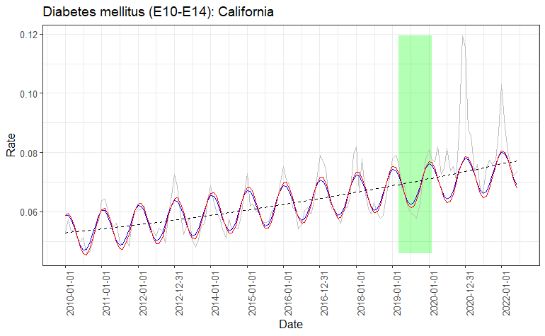
Model Fits Example: Diabetes in CA
Grey curve: observed daily death rate
Black dashed curve: LM prediction (with quadratic term)
Blue curve: NLME prediction using all states
Red curve: NLS prediction using only CA data

Slide 12
State | Observed Death During Testing Months (2019/03/01 to 2020/02/28, % Predicted)
 | Alzheimer disease (G30) | Cerebrovascular diseases (I60-I69) | Chronic lower respiratory diseases (J40-J47) | Diabetes mellitus (E10-E14) | Diseases of heart (I00-I09,I11,I13,I20-I51) | Influenza and pneumonia (J09-J18) | Malignant neoplasms (C00-C97) | Other_rev | Other diseases of respiratory system (J00-J06,J30- J39,J67,J70-J98)
Alabama | -11.1 | 1.0 | -4.3 | 7.7 | -1.6 | -1.7 | -2.3 | 1.1 | -11.8
Arizona | -9.8 | -4.6 | -10.0 | -2.5 | -0.3 | 11.9 | 0.9 | 0.3 | -7.8
California | -6.3 | -2.0 | -0.7 | -0.8 | -1.1 | -2.0 | 0.2 | 2.1 | -0.1
Florida | -19.3 | -0.4 | -3.6 | -0.2 | -1.2 | 3.2 | 0.3 | 0.2 | 0.0
Georgia | -16.9 | -6.6 | -6.8 | -2.4 | 1.5 | -1.7 | 0.8 | 3.0 | -9.8
Illinois | -11.1 | -0.1 | -1.6 | -4.1 | -1.4 | -3.2 | -0.5 | -1.2 | -12.3
Indiana | -13.2 | 5.2 | 2.1 | -6.3 | -0.6 | -3.6 | 1.0 | -1.0 | -1.1
Maryland | -20.7 | 1.0 | 3.7 | 2.8 | -0.1 | -10.6 | -0.8 | -2.5 | -7.6
Michigan | -9.8 | -0.1 | 2.4 | 5.7 | -2.6 | 2.4 | 0.6 | -0.2 | 2.8
Missouri | 3.3 | -3.8 | -5.5 | 1.5 | -1.2 | -12.2 | -0.7 | -1.9 | 6.6
New Jersey | -14.0 | 0.7 | -3.1 | 7.4 | -2.5 | 0.8 | -0.5 | -0.2 | 5.0
New York | -7.4 | -3.5 | 2.6 | 5.5 | -1.9 | 0.6 | 0.0 | 1.3 | 11.0
North Carolina | -8.5 | -2.9 | -3.8 | -4.2 | -0.5 | -7.5 | 0.0 | -0.1 | -8.6
Ohio | -8.8 | -0.5 | -0.9 | 1.4 | -0.1 | -10.0 | -0.9 | -2.0 | -9.1
Pennsylvania | -9.6 | -0.4 | -1.9 | -2.1 | -2.7 | -6.2 | 0.5 | -1.7 | -3.3
South Carolina | -22.4 | -8.6 | -7.1 | 2.4 | -2.6 | -6.7 | -0.8 | 0.5 | 13.4
Tennessee | -14.9 | -2.7 | -3.2 | 10.4 | 1.5 | -8.2 | -0.5 | 2.1 | 12.9
Texas | -11.6 | -7.4 | 0.3 | 11.3 | -2.2 | 5.6 | 2.2 | 2.2 | -10.7
Virginia | -5.8 | 1.5 | 9.1 | 4.0 | 0.6 | -9.3 | 0.5 | 0.7 | 1.5
Washington | -9.3 | -4.5 | -2.8 | -1.3 | 0.4 | 2.0 | 0.0 | 1.9 | 0.2

Slide 13
State | Observed Death During COVID-19 (2020/03/01 to 2022/06/01, % Predicted)
 | Alzheimer disease (G30) | Cerebrovascular diseases (I60-I69) | Chronic lower respiratory diseases (J40-J47) | Diabetes mellitus (E10-E14) | Diseases of heart (I00-I09,I11,I13,I20-I51) | Influenza and pneumonia (J09-J18) | Malignant neoplasms (C00-C97) | Other_rev | Other diseases of respiratory system (J00-J06,J30- J39,J67,J70-J98)
Alabama | -16.4 | -4.1 | -15.1 | 44.9 | 4.6 | -10.3 | -2.4 | 7.9 | -10.8
Arizona | -22.3 | -1.8 | -15.9 | 5.3 | 7.8 | 11.9 | 1.6 | 12.6 | -8.5
California | -11.1 | 0.2 | -7.0 | 12.7 | 2.9 | -11.6 | 2.5 | 14.3 | -12.5
Florida | -25.0 | -0.2 | -13.0 | 21.2 | 1.4 | 12.6 | 2.0 | 6.8 | -12.4
Georgia | -24.4 | -4.0 | -11.8 | 14.1 | 7.1 | 5.5 | 1.3 | 14.4 | -6.5
Illinois | -13.9 | 1.2 | -10.2 | 13.7 | 0.0 | -11.5 | -1.5 | -1.0 | -19.5
Indiana | -26.0 | 3.0 | -5.8 | 11.3 | 0.5 | -16.3 | 1.9 | 2.5 | -6.7
Maryland | -19.7 | -1.2 | -6.8 | 18.5 | 1.7 | -30.2 | -1.4 | -5.0 | -36.2
Michigan | -19.6 | 2.2 | -10.6 | 23.1 | -0.9 | -8.9 | 1.0 | 3.2 | -9.6
Missouri | -11.5 | 3.1 | -8.4 | 13.9 | 3.2 | -16.4 | 3.8 | 3.9 | -3.6
New Jersey | -24.4 | 1.2 | -11.3 | 32.4 | -2.5 | 11.8 | -1.0 | -4.9 | 13.9
New York | -22.7 | -0.8 | -9.9 | 15.9 | 0.4 | -0.4 | -0.2 | 5.2 | 7.1
North Carolina | -21.6 | -1.4 | -16.0 | 10.3 | 3.5 | -22.7 | 0.0 | 5.8 | -13.2
Ohio | -13.3 | 3.3 | -10.3 | 17.5 | 1.3 | -17.0 | -1.2 | -2.0 | -10.1
Pennsylvania | -12.0 | 0.1 | -10.6 | 14.1 | -3.4 | -21.7 | 1.2 | -1.1 | -12.4
South Carolina | -27.4 | -4.9 | -14.4 | 4.5 | 2.8 | -33.1 | -2.8 | 5.1 | 5.7
Tennessee | -24.2 | 8.2 | -10.8 | 33.7 | 9.6 | -11.5 | 2.0 | 14.0 | 13.3
Texas | -16.6 | -2.6 | -6.6 | 28.3 | 2.8 | 10.7 | 4.2 | 14.1 | -15.0
Virginia | -17.6 | 3.0 | -5.6 | 9.6 | 5.0 | -13.6 | 1.9 | 7.9 | -8.5
Washington | -14.3 | -5.7 | -7.3 | 15.9 | 4.8 | -46.2 | 3.2 | 13.5 | -9.7

Slide 14
PCA on observed daily death (as % of predicted)
Influenza death were higher than predicted in TX, FL, AZ, GE and NJ
Diabetes deaths exceeded the predicted the most in NJ, NY and TN

Slide 15
Population dynamics (% Jan 2010) in the US 51 states between Jan 2010 and June 2022
Error bars indicate 95% CI calculated on the Testing data
Green dots are the observed deaths as % of predicated, by State
The model underestimated deaths from Alzheimer even during the Testing years
During COVID-19 years, the predicted death caused by Alzheimer, Chronic Lower Respiratory and Influenza were much lower that expected from the Testing set, while Diabetes death was much higher than expected

Slide 16
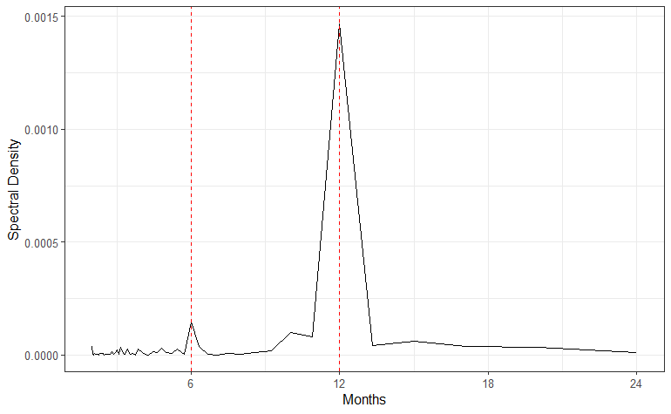
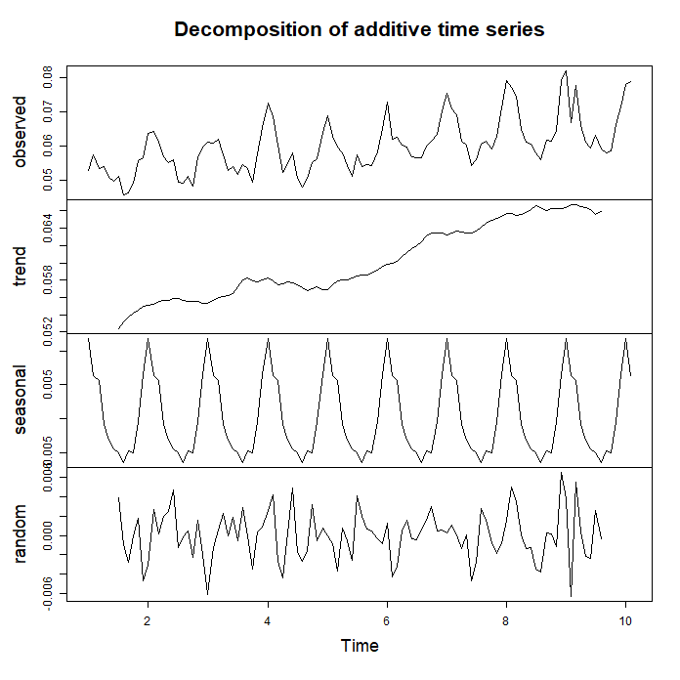
Classical Seasonal Decomposition by Moving Averages (Diabetes in CA Example)
Spectral density analysis of the time series confirmed periodicity of 12 months (R::spectrum)
Increasing trend and seasonality captured (R::decompose), with Random component being an order of magnitude smaller than the Seasonal component

Slide 17
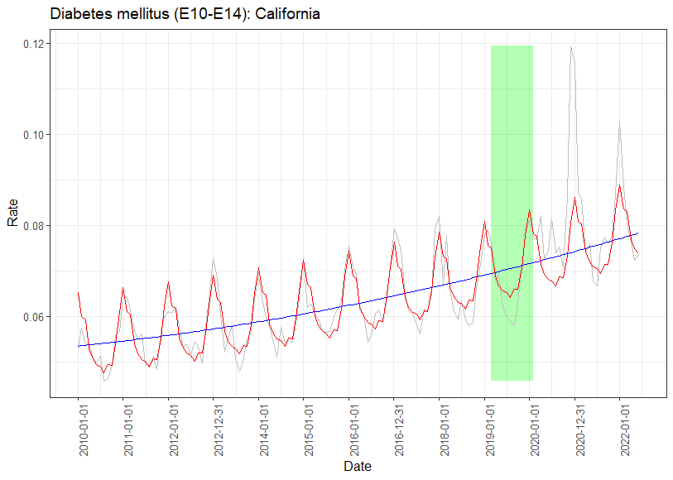
Classical Seasonal Decomposition by Moving Averages (Diabetes in CA Example)
Set | NLME MAPE | CSD MAPE
Training | 4.75 | 3.98
Testing | 5.03 | 4.41
COVID-19 | 10.00 | 8.00

Slide 18
Part II: 2015-2023 Data without Causes of Death

Slide 19
Data processing and subsetting
DeathDaily = Death/daymonth (i.e., average daily death = average monthly death/number of days in that month)
Data starts at 2015-01-01. Removed records: Date >= 2023-05-01
Divided data into training (before 2019/03/01), testing (2019/03/01 to 2020/02/28 or 29) and Covid-19 (2020/03/01 to 2022/06/01)
Calculated Rate (no more zeros) = 10^5*(Deaths/(daymonth*Population)
NOTE: if there were zeros then Rate = 10^5*(Deaths + 1)/(daymonth*(Population + 1))

Slide 20
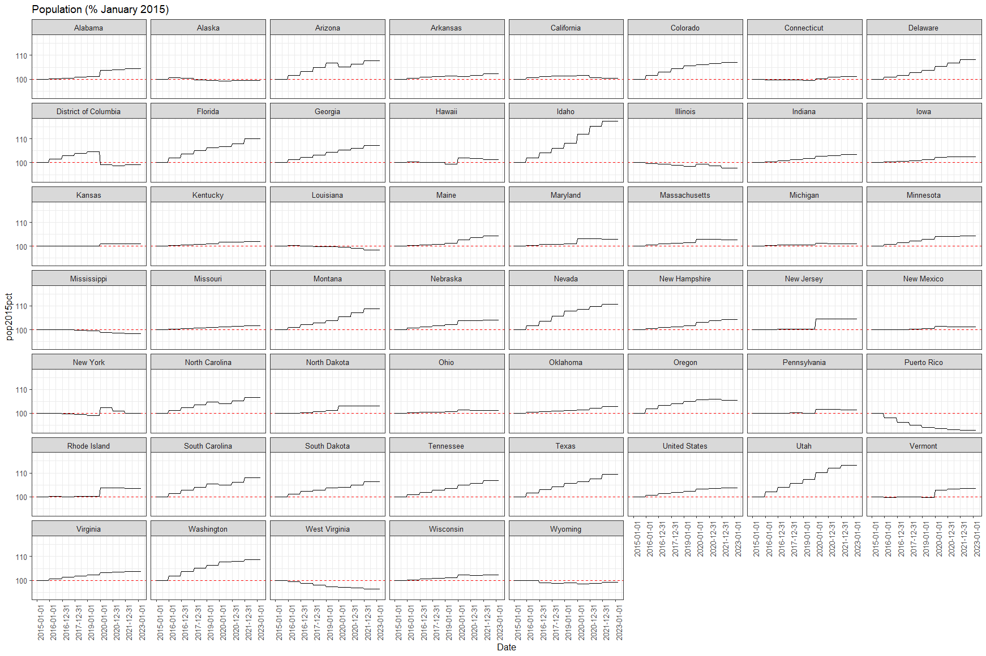
Population dynamics in the US states and territories
by State between Jan 2015 and May 2023

Slide 21
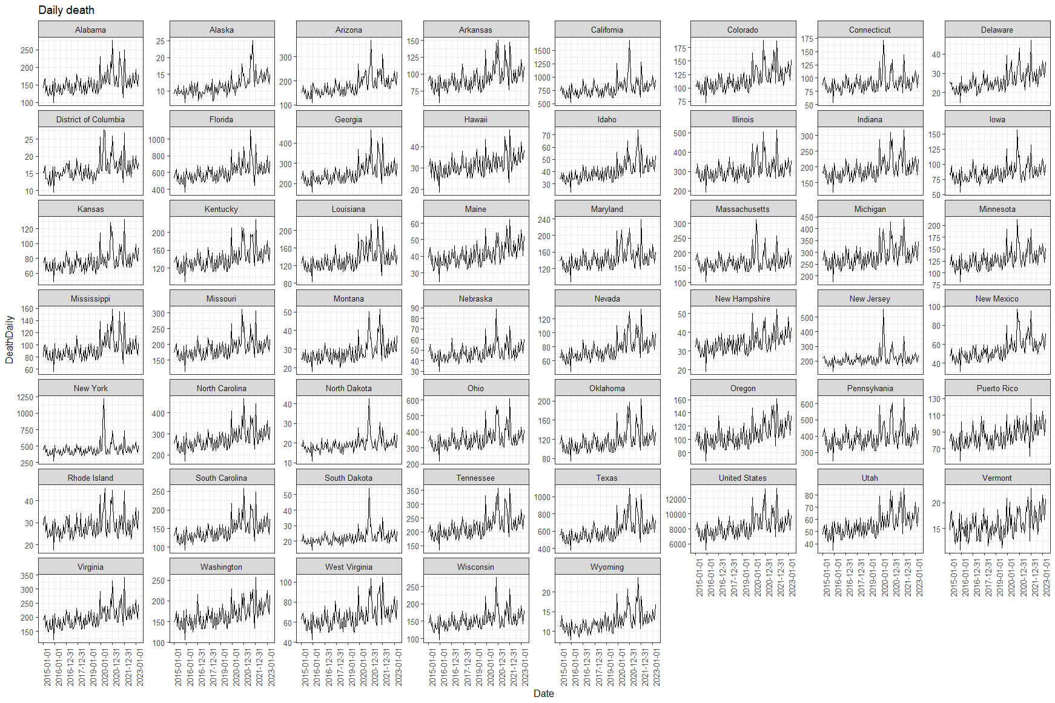
Daily All-Cause Death in the US states and territories
by State between Jan 2015 and May 2023

Slide 22
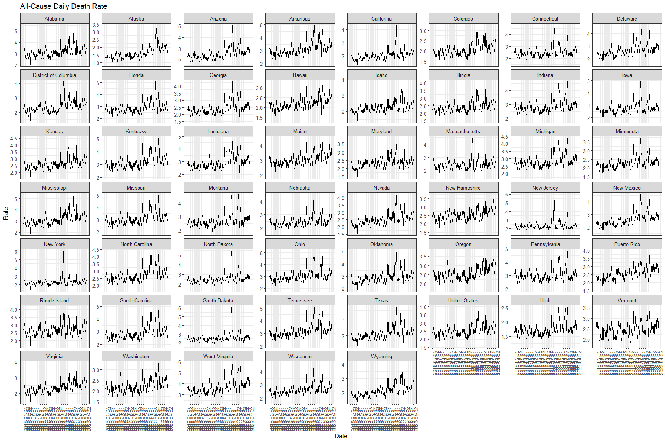
Daily All-Cause Death Rate in the US states and territories
by State between Jan 2015 and May 2023, per 10^ of Population

Slide 23
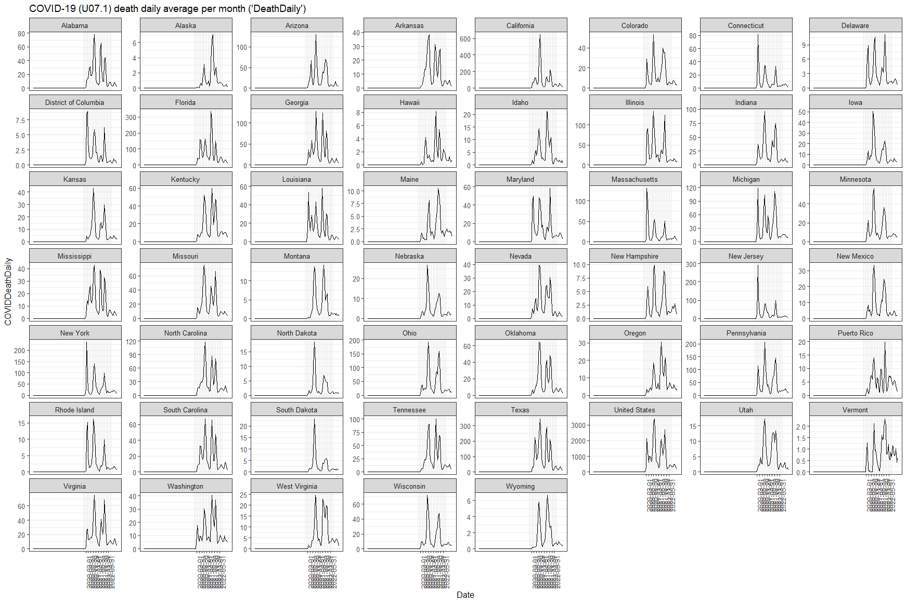
Daily COVID-19 Death in the US states and territories
by State between Jan 2015 and May 2023

Slide 24
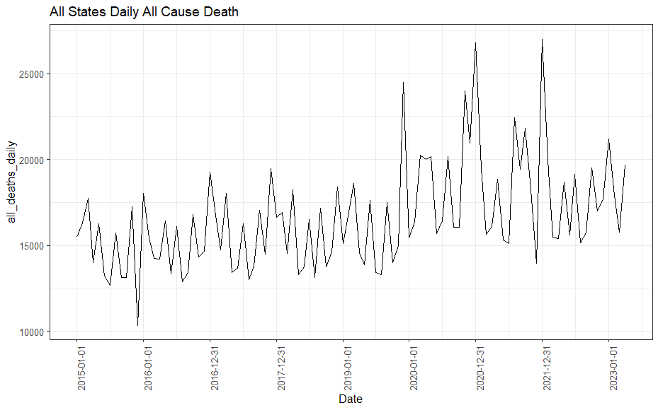
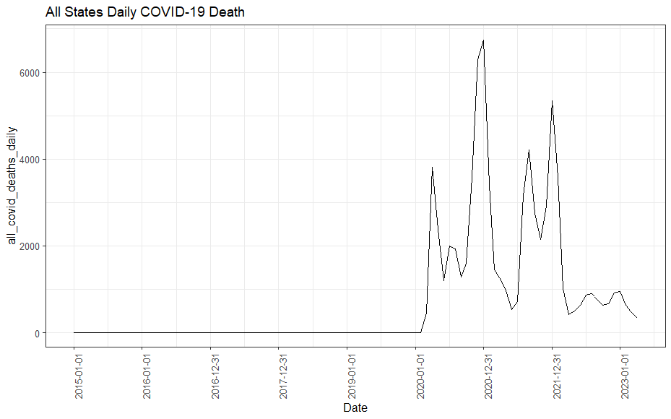
Daily COVID-19 Death in the US states and territories
All States Combined between Jan 2015 and May 2023

Slide 25
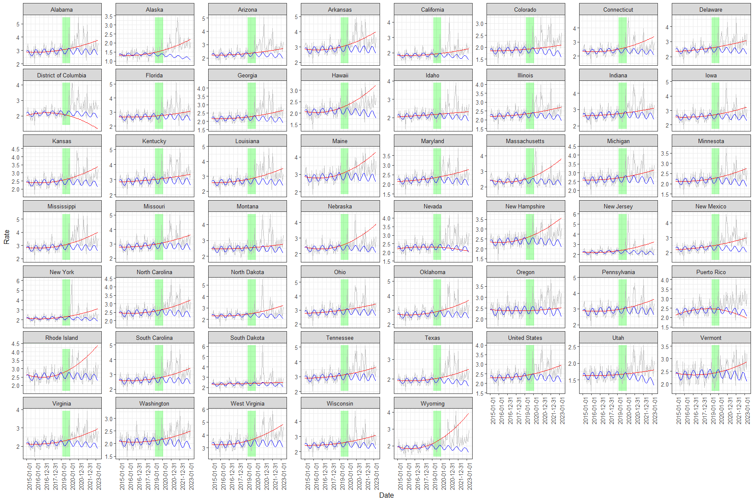
Daily All-Cause Death Rate in the US states and territories
by State between Jan 2015 and May 2023, per 10^ of Population
Quadratic and Sinusoidal Fits

